Slide 1
Category review: Chips
June 2020
Retail Analytics
Brand note: If client logo is not required, use alternate title page layout right click slide thumbnail > Layout > Title

Slide 2
Notes:
To view Privacy video explaining how important data privacy is to Quantium, please click here: https://www.youtube.com/watch?v=Zq1QDAkoRzU
or here Q:\Company Reference\Brand & Design\Brand videos\Q Privacy.mp4
At Quantium, we believe that data is the behavioural footprint of humanity and that it has to be treated with the utmost care and responsibility.
Histories, attitudes, indeed lives are stored within it in ways that aren’t always apparent – and that’s what makes its potential so powerful.
To work with it responsibly, sensitively, we set ourselves the highest data privacy protection and governance standards.
We have spent 17 years perfecting privacy-by-design and secure-by-design principles. Central to this is not holding any personally identifiable information about people –
we neither receive it, and put the necessary protections in place to be unable to decipher it.
Every aspect of handling data is safeguarded: from its de-identification, to its encryption – data security is paramount and of the highest grade.
We pride ourselves on gaining the trust of iconic organisations around the world through years of securely working with their data,
and in turn the trust that builds with their stakeholders.

Slide 3
Executive summary
01
Chips Category Review
Chips transactions increase substantially prior to Christmas. It is a good time to take advantage of this momentum with promotional offers.
Older and Young Family segment have the highest average purchase units per unique customer.
Sales mainly came from Budget - older families, Mainstream - young singles/couples, and Mainstream - retirees. In total contributing 25% of sales revenue.
02
Trial Store Analysis
Trial store 77 and 86 experienced significant increase in Total Sales and Customers quantity during the trial period compared to their control stores..
Trial store 88 experience increase as well, but insignificant compared to its’ Control store.

Slide 4
01
Category

Slide 5
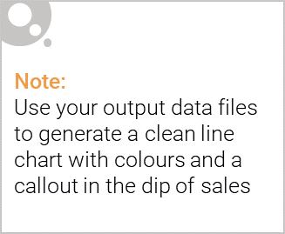
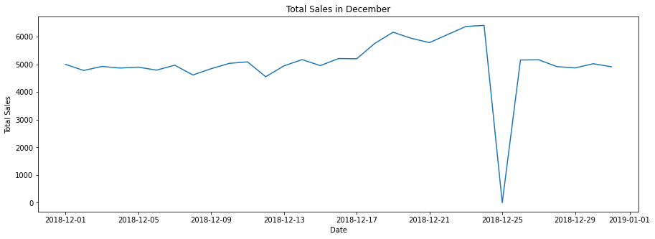
Sales increase steadily approaching Christmas, and return again to early
December sales level during New Year Eve. Dipped sales in 25th December
was due to shops being non-operational during Christmas.

Slide 6

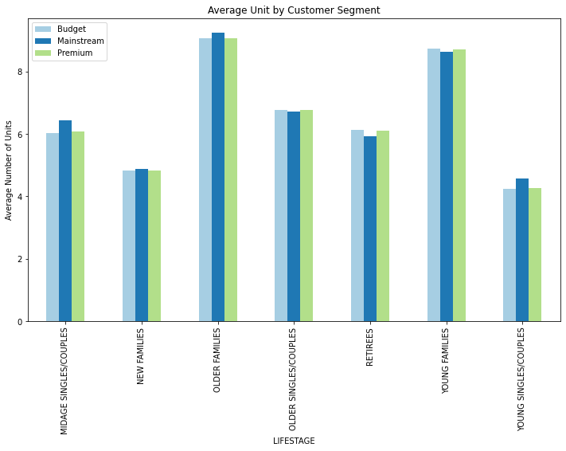
Affluence doesn’t seem to affect quantity of purchase per customer.
Older and Young Family segment have the highest average purchase units
per unique customer.

Slide 7
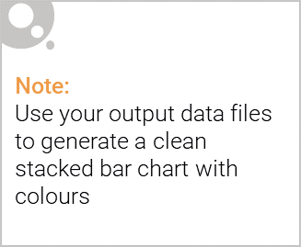
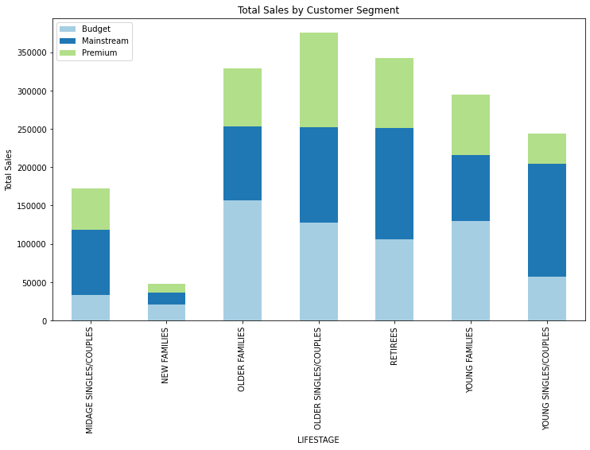
Editable (delete this)
Sales mainly came from Budget - older families, Mainstream - young
singles/couples, and Mainstream - retirees. In total, older customers buy
more than younger customers. Non-premium customers buy more than
premium customers.

Slide 8
02
Trial store performance

Slide 9
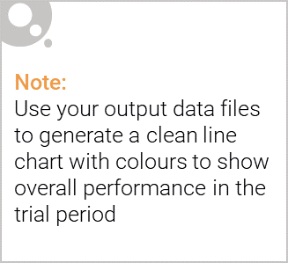
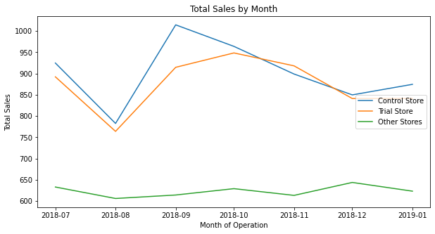
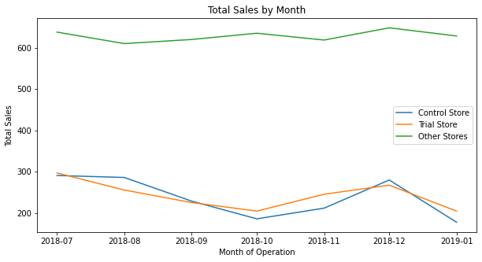
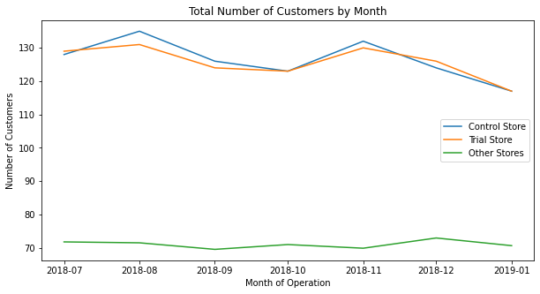
Trial store 77 second and third month, and trial store 86 second month had
significantly higher sales than Control store.
Whereas trial store 88 sales increase is insignificant.
Trial Store 86
Trial Store 77
Trial Store 88

Slide 10
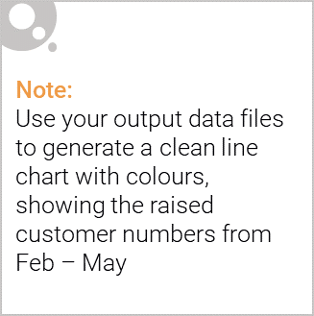
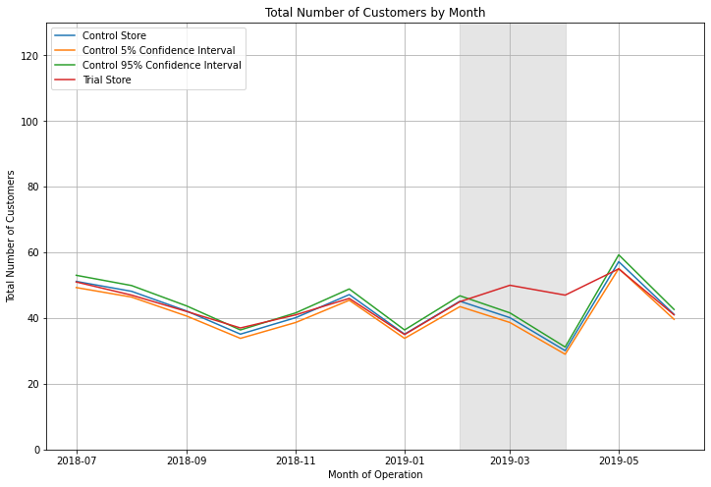
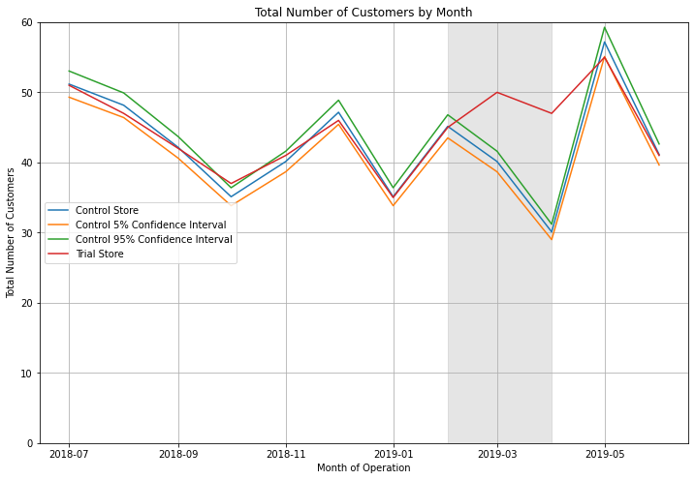
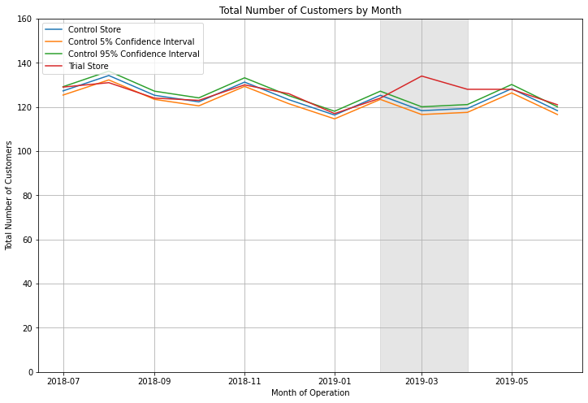
Trial Store 86
Trial store 77 and 86 had significant increase in number of customers during
Trial period compared to Control stores, proving an effective trial run.
Whereas trial store 88 customers increase is insignificant.
Trial Store 77
Trial Store 88

